Slide 1

DATA ANALYSIS ON ONLINE RETAIL DATASET
Guided By,
Shri. D. K. Patel
Group Members :
Hinal, Mukund, Shridhar, Mrinal, Keerti

Slide 2
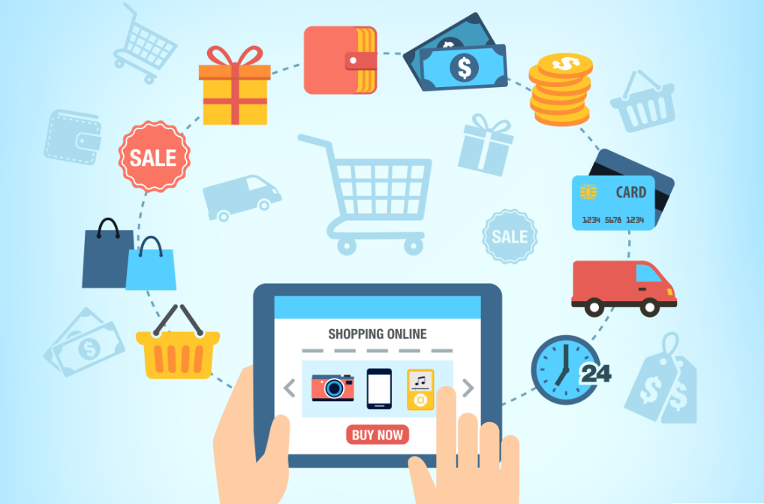
INTRODUCTION
The online retail store industry is a multi-billion dollar industry. It touches everyone on society since we all eat. Through tough competition a grocery chain must run efficient and reduce cost overruns.
This includes using updated information in its purchasing decisions, inventory control, store stocking, customer satisfaction, buying trends, and a host of other business concerns.

Slide 3
OBJECTIVE
To study the Customer Segmentation
RFM (Recency, Frequency, Monetary Value) analysis
To discover Patterns in Customers Transactions of groceries dataset
To build a Recommendation System
Identify products that are suitable for cross-selling and upselling

Slide 4
DATASET
Dataset – Online Retail Dataset
Source - https://www.kaggle.com/puneetbhaya/online-retail.
The Online Retail a transacational data set which contains all the transactions occurring between 01/12/2010 and 09/12/2011 for a UK-based and registered non-store online retail. The company mainly sells unique all-occasion gifts. Many customers of the company are wholesalers.

Slide 5
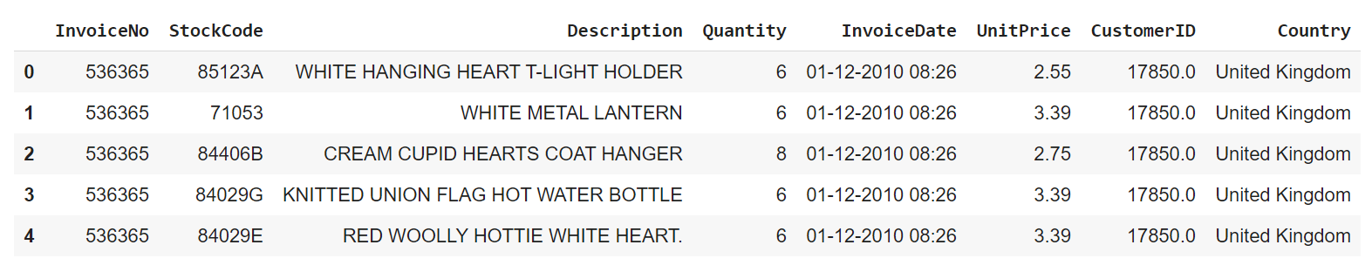
DATASET

Slide 6
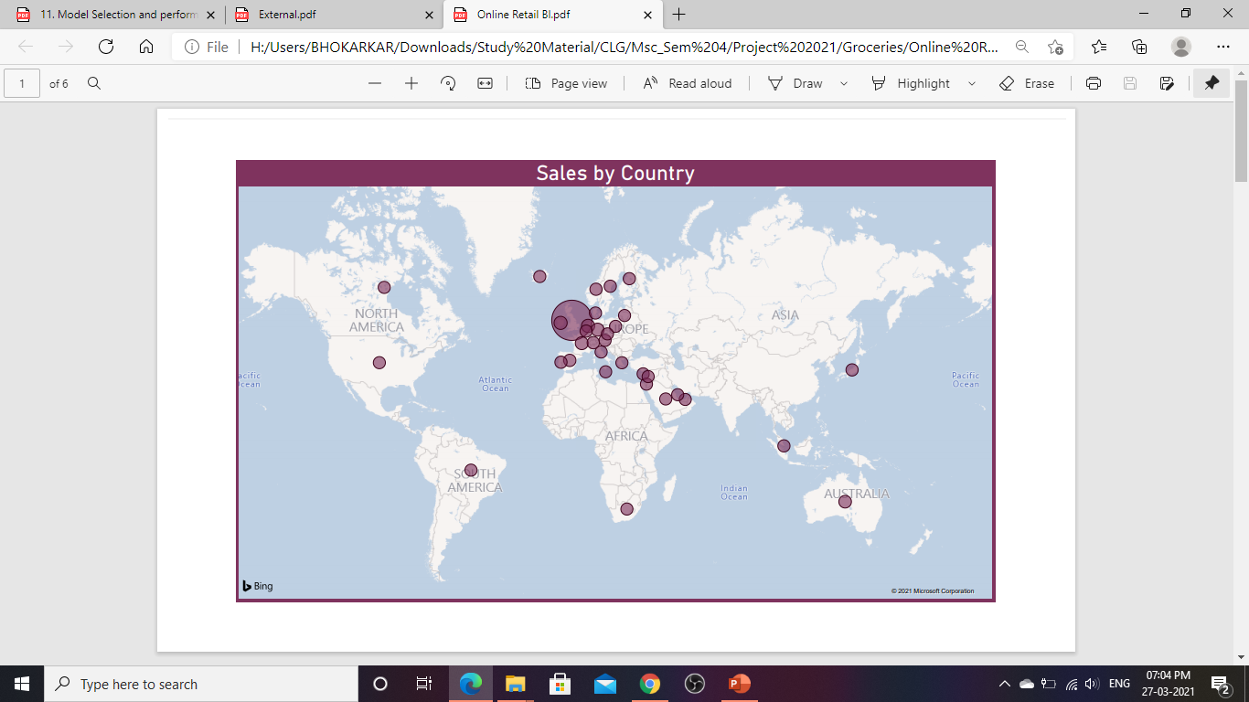
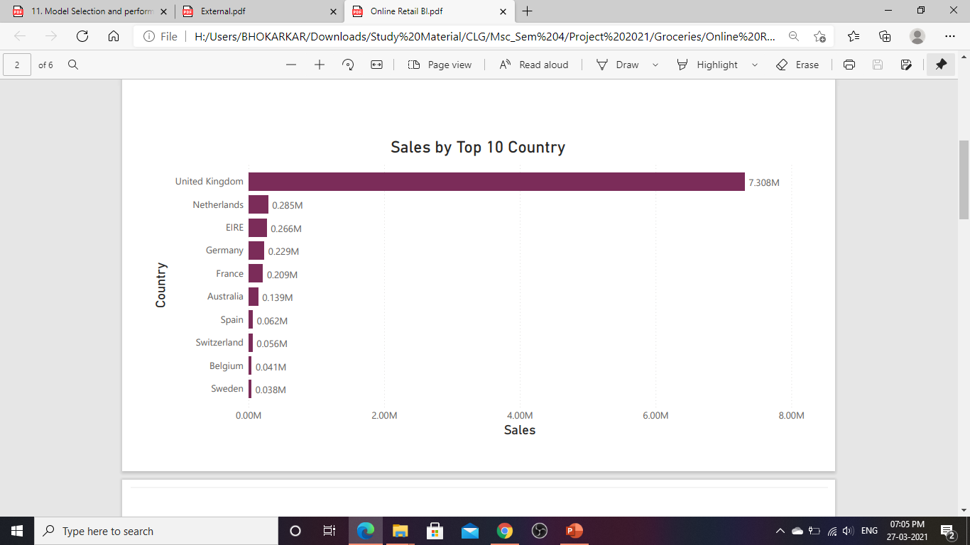
DATA VISUALIZATIONS According to Sales

Slide 7
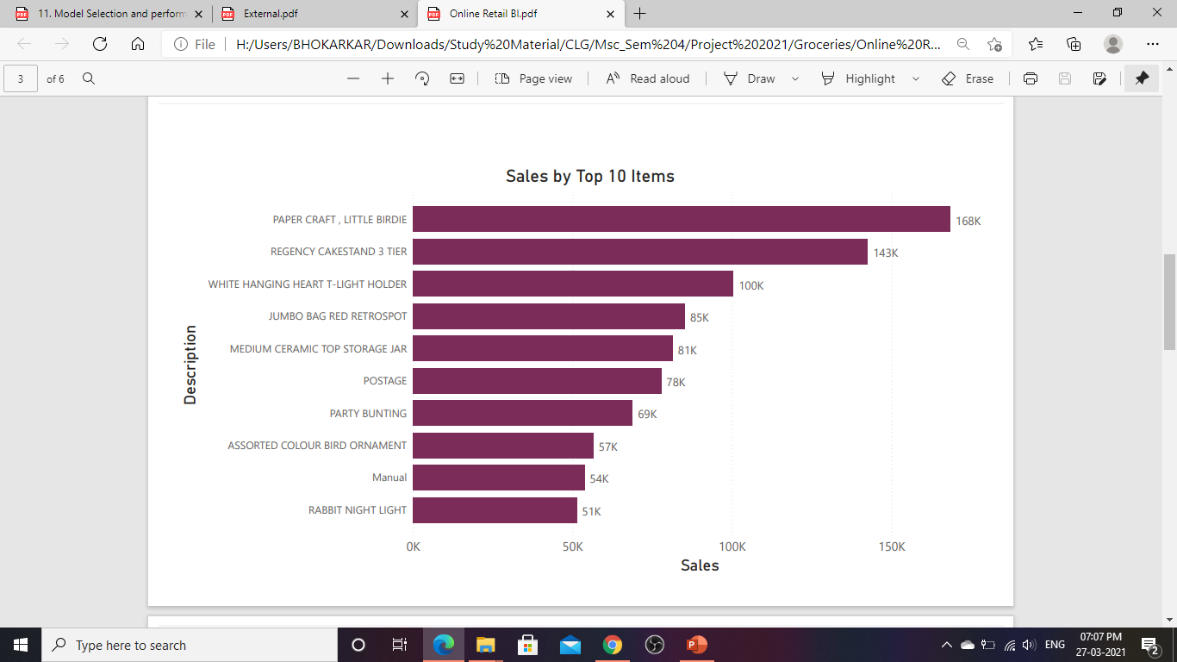
DATA VISUALIZATIONS According to Sales

Slide 8
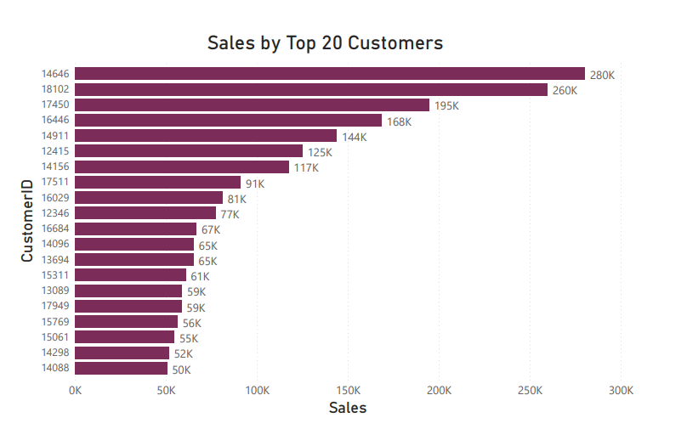
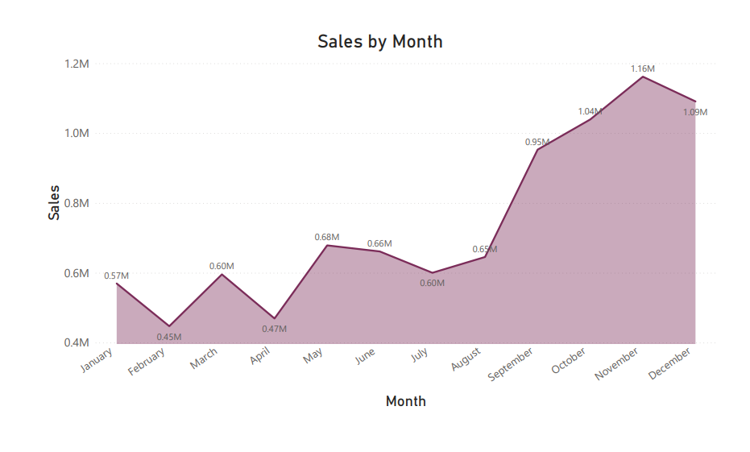
DATA VISUALIZATIONS According to Sales

Slide 9
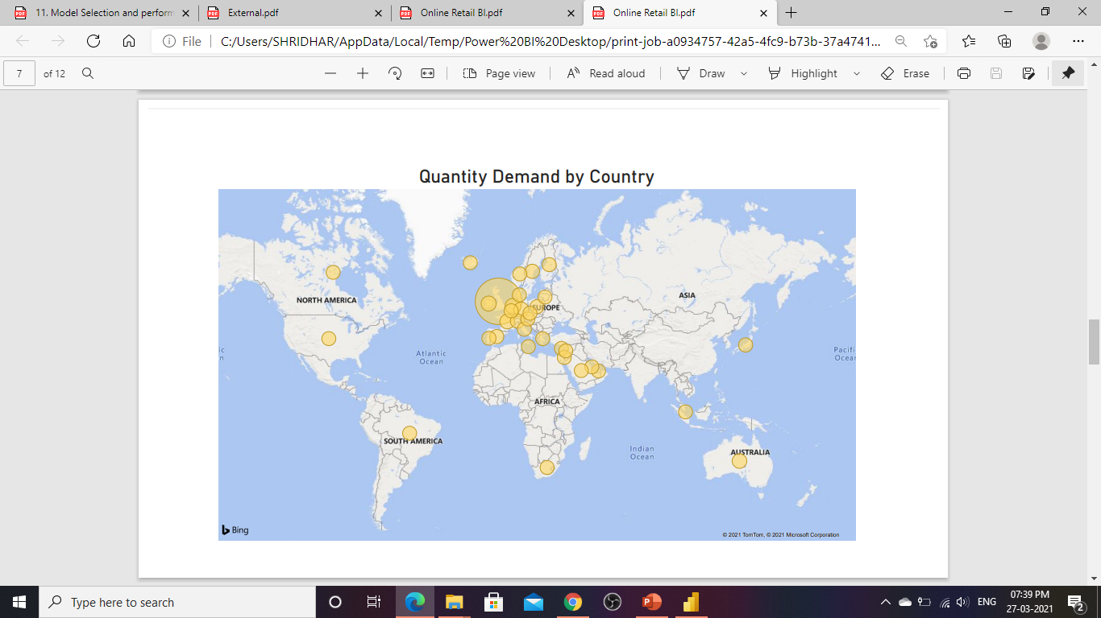
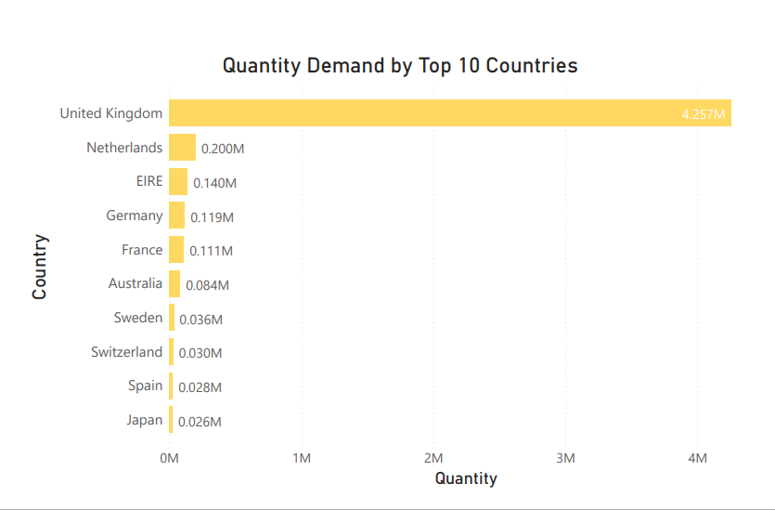
DATA VISUALIZATIONS According to Quantity

Slide 10
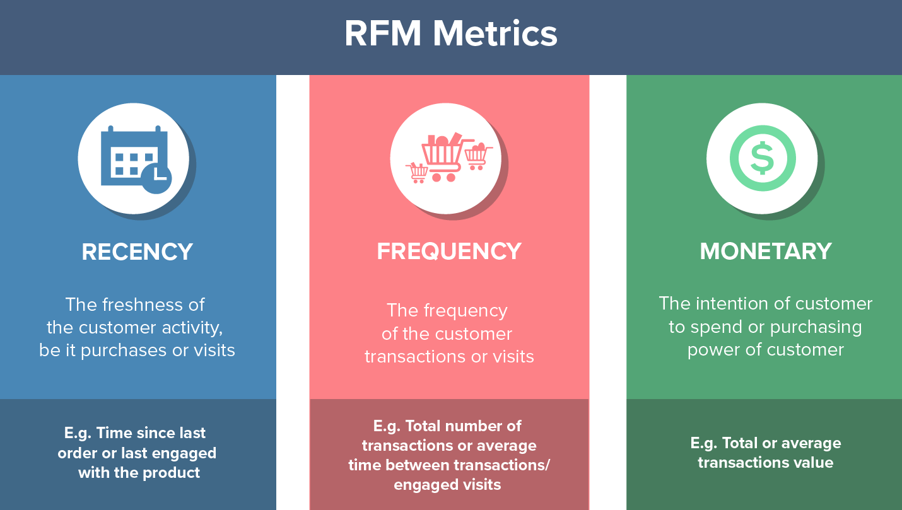
CUSTOMER SEGMENTATION
Customer segmentation is the process of dividing customers into groups based on common characteristics so companies can market to each group effectively and appropriately.

Slide 11
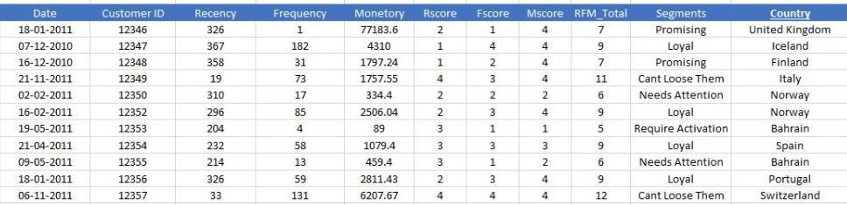
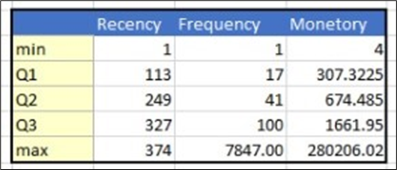
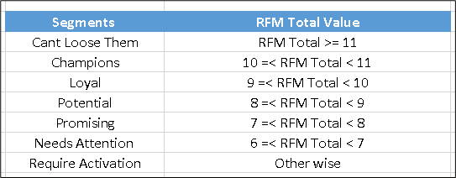
CUSTOMER SEGMENTATION

Slide 12
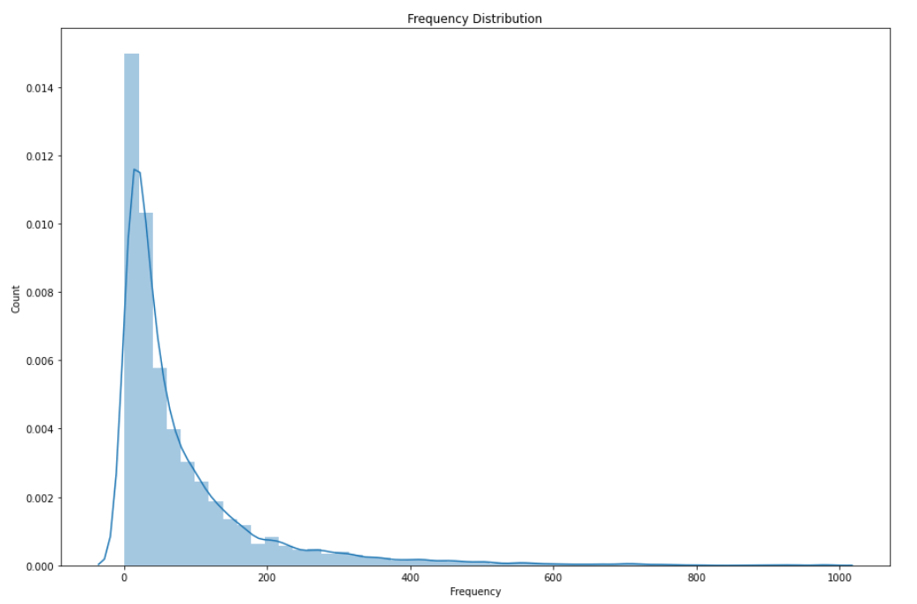
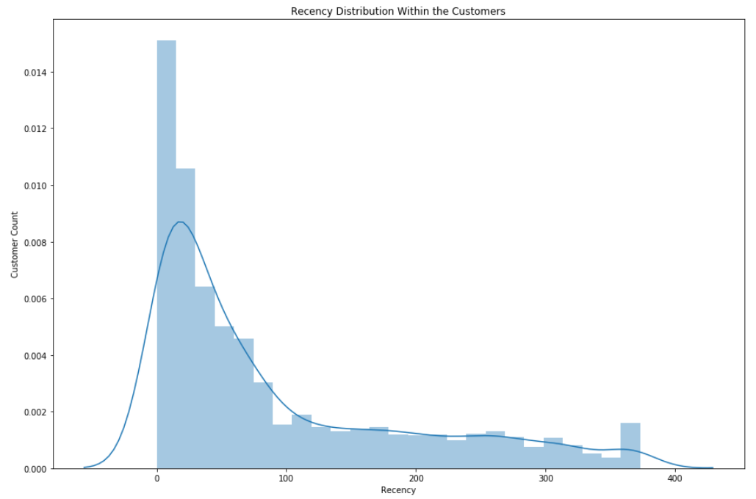
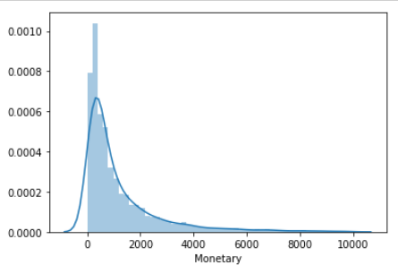
DISTRIBUTION OF RFM
RECENCY
FREQUENCY
MONETARY

Slide 13
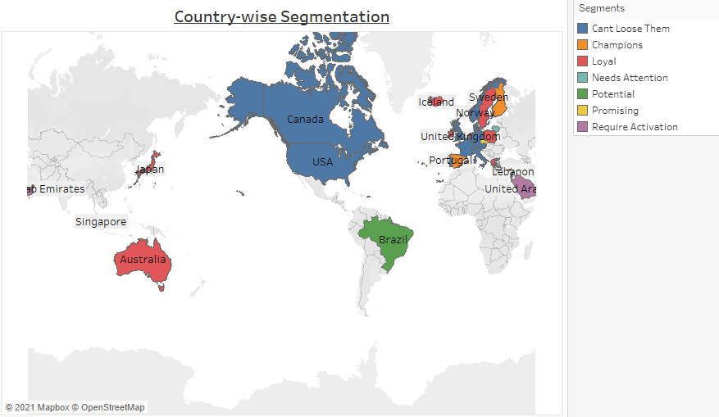
COUNTRY WISE CUSTOMER SEGMENTATION

Slide 14
CUSTOMER LIFETIME VALUE
CLV = (( Average Sales * Purchase frequency) / Churn)* Profit Margin
Where,
Average Sales = (Total Sales) / (Total no. of Orders)
Purchase Frequency = (Total no. of orders) / (Total unique Customers)
Retention Rate = ( Total no. of orders greater than 1) / (Total unique Customers)
Churn = 1- Retention Rate
(Assumption: In this Calculation we have taken 5% as Profit Margin for the Retailer)

Slide 15
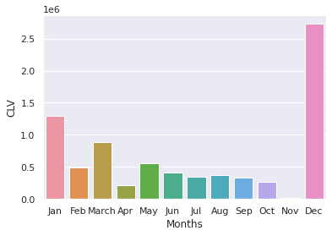
CUSTOMER LIFETIME VALUE
High CLV in January & December, so we can recommend the retail company to conduct appropriate marketing campaigns in upcoming next year for these months to retain the customers.
Marketing Campaigns such as : Advertisement Campaign, Email Marketing Campaign, SMS/Direct Messaging Campaign, Telemarketing, Sales Promotion, Exhibitions or Trade Shows

Slide 16
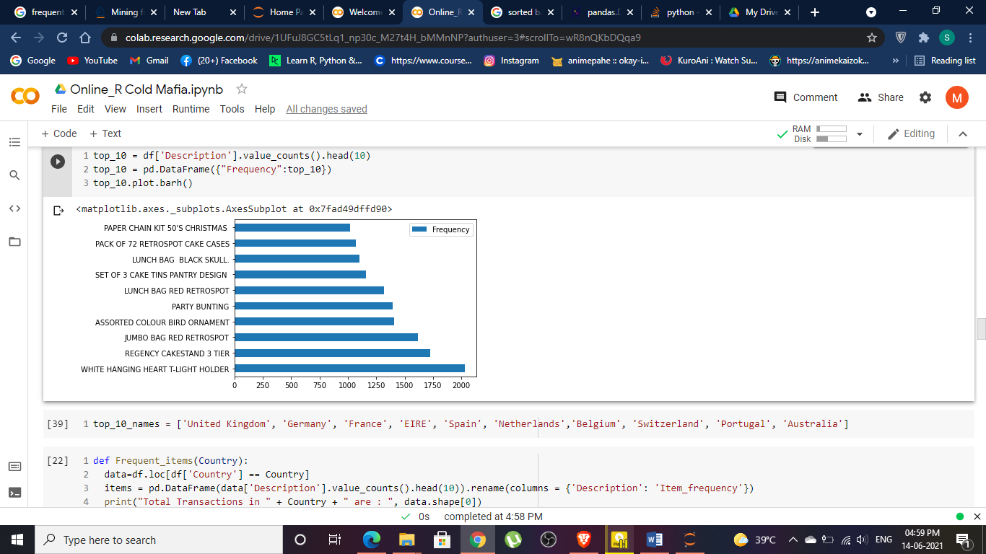
FREQUENT ITEMS AND THEIR PATTERNS
Top 10 Frequent items

Slide 17
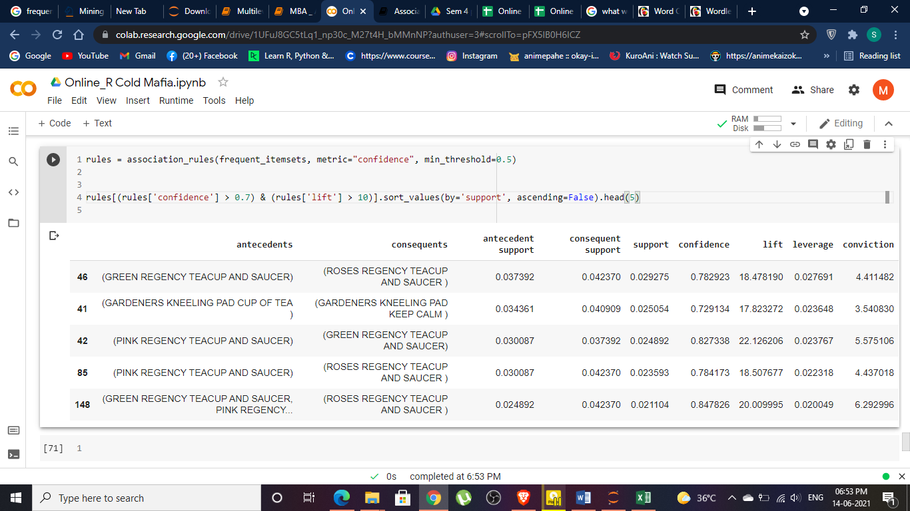
FREQUENT ITEMS AND THEIR PATTERNS

Slide 18
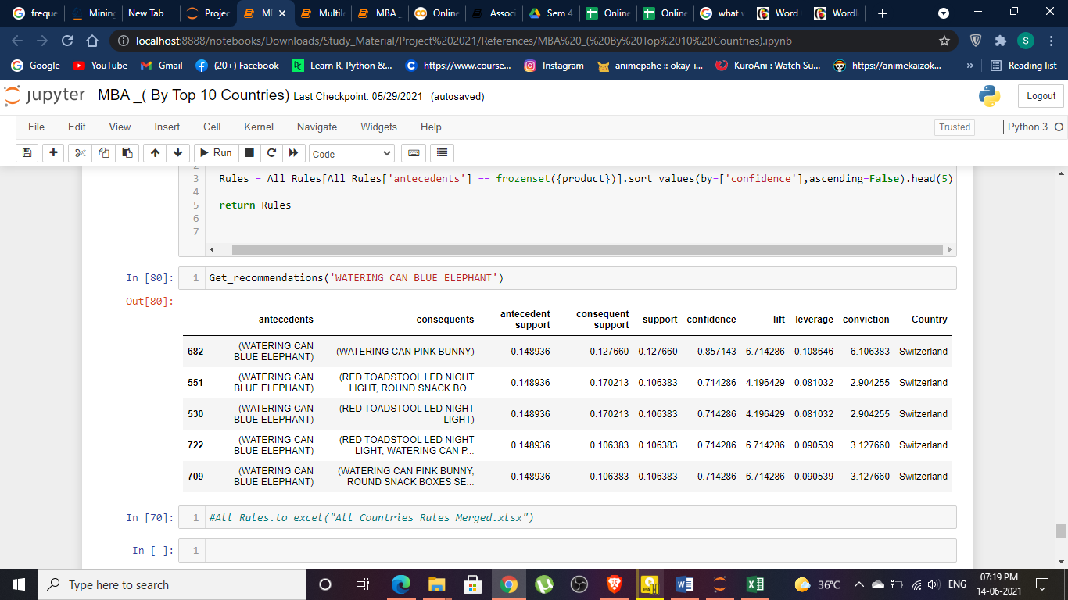
RECOMMENDATIONS BY ASSOCIATION RULE MINING

Slide 19
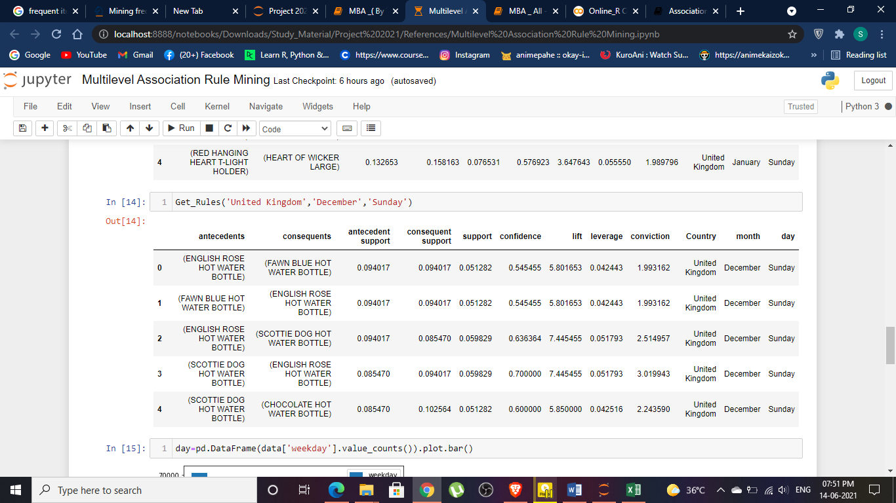
RECOMMENDATIONS BY MULTI-LEVEL ASSOCIATION RULE MINING

Slide 20
RECOMMENDATION SYSTEM
We have developed a recommendation system by using an item-based collaborative filtering algorithm on the Online Retail Dataset.
In this Recommendation system implementation, we have randomly selected an item from which we made recommendations of 5 similar items .
Construction - RFM by items
Stock Code | Frequency | Recency | Monetary_Value | R | F | M | RFM_Score
10002 | 36 | 138 | 18 | 4 | 2 | 3 | 9
10080 | 19 | 267 | 5 | 3 | 2 | 1 | 6
10120 | 23 | 366 | 1 | 2 | 2 | 1 | 5
10125 | 46 | 373 | 20 | 1 | 3 | 3 | 7
10133 | 77 | 280 | 14 | 3 | 3 | 2 | 8

Slide 21
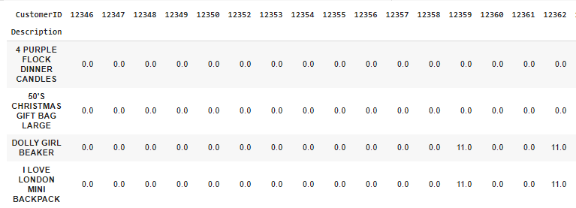
ITEM USER MATRIX
Then by help of pivot_table(), we made our feature matrix, which is an item-user matrix.

Slide 22
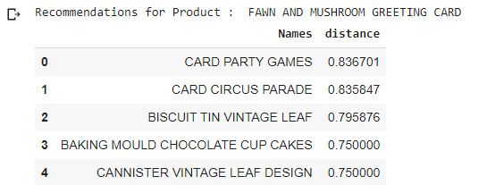
RECOMMENDATION SYSTEM
Result - For item name: “FAWN AND MUSHROOM GREETING CARD”
The most similar item we got is “CARD PARTY GAMES”
And the least similar item we got is “CANISTER VINTAGE LEAF DESIGN”

Slide 23
CONCLUSIONS
From Customer Segmentation we concluded that we have to focus on 197 customers which we can't lose. And also we have a great number of loyal customers so we have to make exciting offers to continue their loyalty.
From the Customer Life -Time value we can conclude that high CLV in January & December, so we can recommend the retail company to conduct appropriate marketing campaigns in upcoming next year for these months to retain the customers.

Slide 24
CONCLUSIONS
From the Recommendation System,
We got the most similar item which is here “CARD PARTY GAMES” purchased on a regular transaction and also the least similar item which is here “CANISTER VINTAGE LEAF DESIGN”.
So from this we can conclude that we should recommend these items to the new customers and also prepare some offers regarding this product to the loyal and champion customers (regular customers).
Also this recommendation system might be used for the purpose of creating a web application.
These types of Recommendations can help to identify the products that are appropriate for cross-selling or up-selling.

Slide 25
REFERENCES
Data Mining. Apriori Algorithm and Association Rules | by Hussein Chawich | Improving Search Engine with a Data Mining Technique | Medium
Database marketing – Analysis and Managing customers by Robert C. Blattberg, Byung-Do Kim and Scott A. Neslin
Data mining-Concepts and Techniques by Jiawei Han, Micheline Kamber and Jian Pei
Customer Segmentation Definition - What is Customer Segmentation (shopify.in)
Association rules - mlxtend (rasbt.github.io)
Apriori Algorithm - GeeksforGeeks

Slide 26
THANK YOU !

